Slide 1
Design and Analysis of Algorithms (ICT 2257) 4 - Credits[L-3 T-1 P-0 4]
B.Tech. (Computer and Communication Engineering)
Dr. Ajitha Shenoy K B & Dr. Raghavendra S

Slide 2
Syllabus
Introduction:
Asymptotic Notations
Space and Time Complexity
Graphs:
Representations of Graph and Digraphs
DFS, BFS
Finding path and connected components
Spanning tree

Slide 3
Syllabus Contd…
Greedy Method:
Container Loading Problem
0/1 Knapsack Problem,
Topological Sorting
Single Source Shortest Path
Bipartite Cover
Minimum Spanning Tree
Divide and Conquer:
Strassen’s Matrix Multiplication
Binary Search
Merge Sort
Quick Sort
Solving Recurrence Equations

Slide 4
Syllabus Contd…
Dynamic Programming:
0/1 Knapsack Problem,
Matrix Multiplication Chain Problem
All Pair Shortest Path
Back Tracking and Branch & Bound Methods:
0/1 Knapsack Problem
Max Clique Problem
Traveling Salesperson Problem (TSP)

Slide 5
Syllabus Contd…
Trees:
Binary Search Tree
AVL Tree, Red Black Tree
B Tree
B+ Tree etc.
Hashing:
Hash function
Collision resolution techniques:
open addressing: Separate chaining
Closed addressing: Linear probing, Quadratic probing, double hashing

Slide 6
Syllabus Contd…
NP-Completeness and Approximation Algorithms:
Class P Problems
Class NP Problems
NP – hard Problems
NP - complete Problems
Approximation Algorithms
Vertex Cover Problem
TSP

Slide 7
Course Outcomes
By the end of this Course, the students should be able to:
Understand asymptotic notations to represent the complexities of algorithms.
Understand the basic concepts of graph traversal methods.
Apply various algorithm designing techniques for a given problem.
Comprehend the basic concepts of trees and hashing techniques.
Understand NP complete and NP hard problems.

Slide 8
References
T.H. Cormen, C.E. Leiserson, R.L. Rivest, C. Stein, Introduction to Algorithms (3e), Prentice-Hall India, 2009.
Sartaj Sahani, Data Structures, Algorithms and Applications in C++ (2e), Silicon Press, 2005.
Mark Allen Weiss, Data Structures and Algorithm Analysis in C, Pearson Education (3e), 2009.

Slide 9
Define Set
Define Graph
Define Tree
There are n stairs, a person standing at the bottom wants to reach the top. The person can climb either 1 stair or 2 stairs at a time. Count the number of ways, the person can reach the top.
In mathematics and computer science, an algorithm is a finite sequence of well-defined, computer-implementable instructions, typically to solve a class of problems or to perform a computation. Algorithms are always unambiguous.
Algorithm: Name of Persian mathematician Muhammad ibn Musa al-Khwarizmi - was a Persian mathematician, astronomer, geographer, and scholar in the House of Wisdom in Baghdad.

Slide 10
Asymptotic Notations
Θ, O, Ω, o, ω
Theta, Big-Oh, Big-Omega/Omega, small/little oh, small/little omega.
Used for comparing two functions say f(n) and g(n).
Need this notation for analysis of algorithm – i.e., to analyze time complexity/space complexity of an algorithm as a function of input size n say f(n). n is positive integer and f(n) is monotonically increasing function (in the case of time and space complexity).

Slide 11
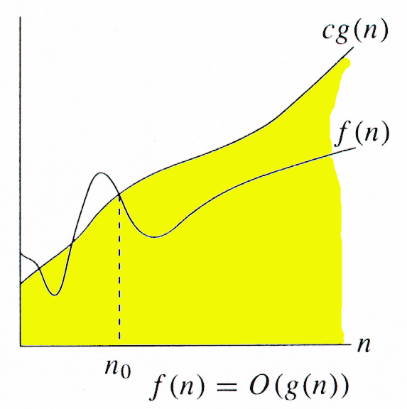
Big-Oh (O)
f(n)=O(g(n)) iff ∃ positive constants c and n_{0,} such that ∀n ≥ n₀,
such that f(n) ≤ cg(n)
g(n) is an asymptotic upper bound for f(n).

Slide 12
Examples
Any linear function an + b is in O(n²). How?
an + b ≤ |a| n² +|b| n² for all n ≥ 1
= (|a|+|b|) n² = O(n²)
Another way:
an + b ≤ n² + n² for all n ≥ max{|a|, |b|}
= 2 n² = O(n²)
Whether an+b=O(n) ?
Yes.
an + b ≤ |a|n + n for all n ≥ b
= (|a|+1) n
Taking c = (|a|+1) and n_{o}=b we get an+b=O(n)
an + b <= c n <= cn^2 <= cn^3 … etc.

Slide 13
Examples: f(n) =3n + 5 <= 3 n^2 + 5 n^2 for all n greater than or equal to 1
= 8 n^2 for all n >= 1
C=8 n0 = 1 f(n)=O(n^2)
f(n)= 3n + 5 <= 3n^2 + n^2 for all n >=5
=4 n^2
= O(n^2) c=4 and n0=5
F(n)= 3n + 5 and g(n)=n
F(n)=O(g(n))?
F(n)=3n + 5 <= 3n + n for all n >=5 3n+5 <= 4n therefore, O(n)
F(n)=3n+5 <= 3n +5n for all n >=1, 3n +5 <= 8n therefore, O(n)

Slide 14
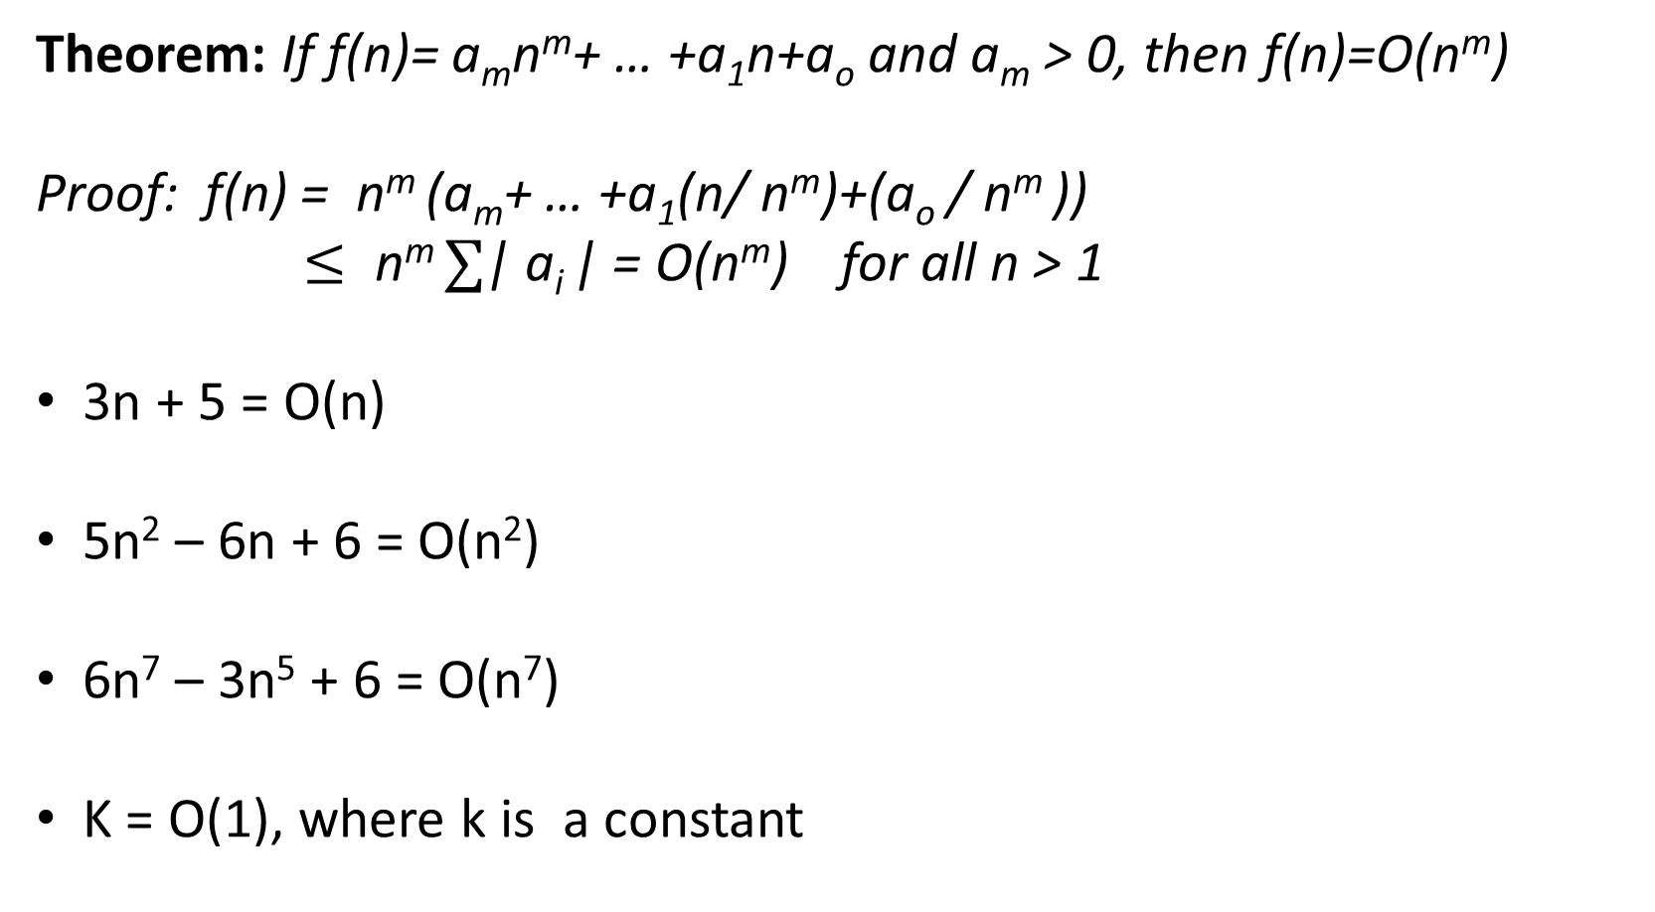
Theorem: If f(n)= a_{m}n^{m}+ … +a₁n+a_{o} and a_{m} > 0, then f(n)=O(n^{m})
Proof: f(n) = n^{m} (a_{m}+ … +a₁(n/ n^{m})+(a_{o} / n^{m} ))
$≤ \text{n}\text{m} ∑$| a_{i} | = O(n^{m}) for all n > 1
3n + 5 = O(n)
5n² – 6n + 6 = O(n²)
6n⁷ – 3n⁵ + 6 = O(n⁷)
K = O(1), where k is a constant

Slide 16
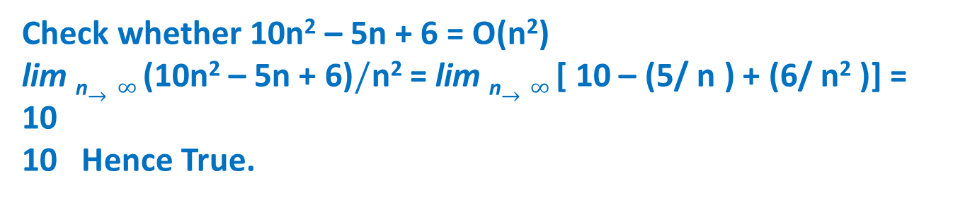
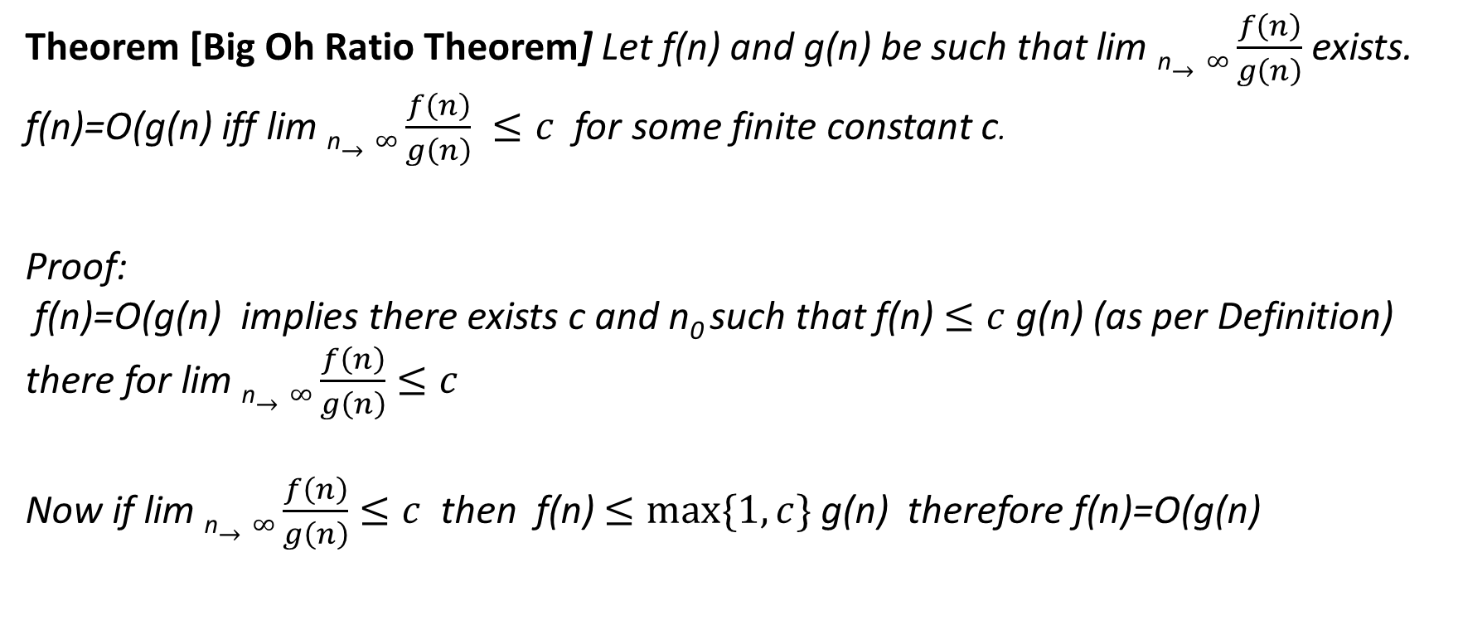
Big Oh Ratio Theorem
Theorem [Big Oh Ratio Theorem] Let f(n) and g(n) be such that lim _{n}$→∞\frac{f\left(n\right)}{g\left(n\right)}$ exists. f(n)=O(g(n) iff lim _{n}$→∞\frac{f\left(n\right)}{g\left(n\right)} ≤c$for some finite constant c.
Proof:
f(n)=O(g(n) implies there exists c and n₀ such that f(n) $≤c$g(n) (as per Definition) there for lim _{n}$→∞\frac{f\left(n\right)}{g\left(n\right)}$ $≤c$
Now if lim _{n}$→∞\frac{f\left(n\right)}{g\left(n\right)}$ $≤c$ then f(n) $≤max⁡\{1, c\}$g(n) therefore f(n)=O(g(n)
Check whether 10n² – 5n + 6 = O(n²)
lim _{n}$→∞ \text{(1}\text{0}\text{n}\text{2}\text{ – 5}\text{n}\text{ + 6)}/\text{n}\text{2}$ = lim _{n}$→∞$[ 10 – (5/ $\text{n}$ ) + (6/ $\text{n}\text{2}$ )] = 10
10 Hence True.

Slide 17
Solve the following:
d) lim _{n}$→∞\frac{15n3 logn+16n2 }{n3}$ = lim _{n}$→∞$ $\frac{15n3 logn }{n3}$ + $\frac{16n2 }{n3}$ = $∞$

Slide 18
Show that p(n) is asymptotically bigger than q(n)
f(n) =O(g(n)) iff f(n) <= c g(n) g(n) is asymptotically bigger than f(n)
Lim n-> inf q(n)/p(n) = lim n-> inf (100 n2^n + 33 n)/(17n^2 2^n) = lim n-> inf 100/n + 33/17n2^n = 0
Using Big Oh Ratio theorem
q(n)=O(p(n))

Slide 19
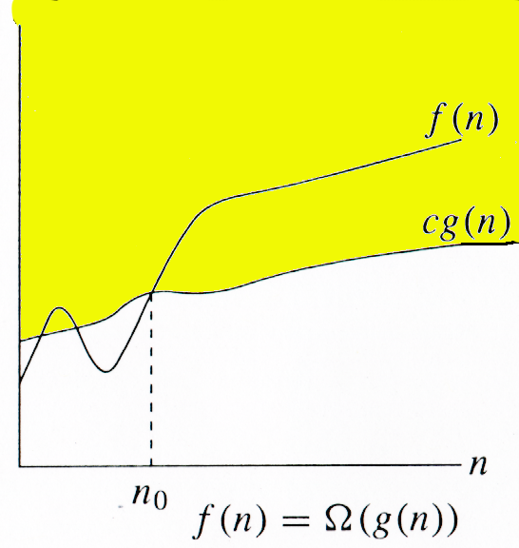
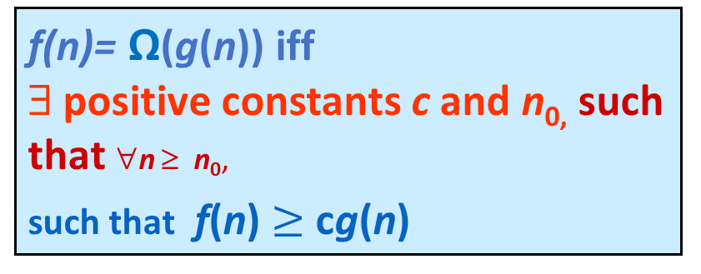
Omega Notation (Ω)
f(n)= Ω(g(n)) iff ∃ positive constants c and n_{0,} such that ∀n ≥ n₀,
such that f(n) $≥$ cg(n)
g(n) is an asymptotic lower bound for f(n).

Slide 20
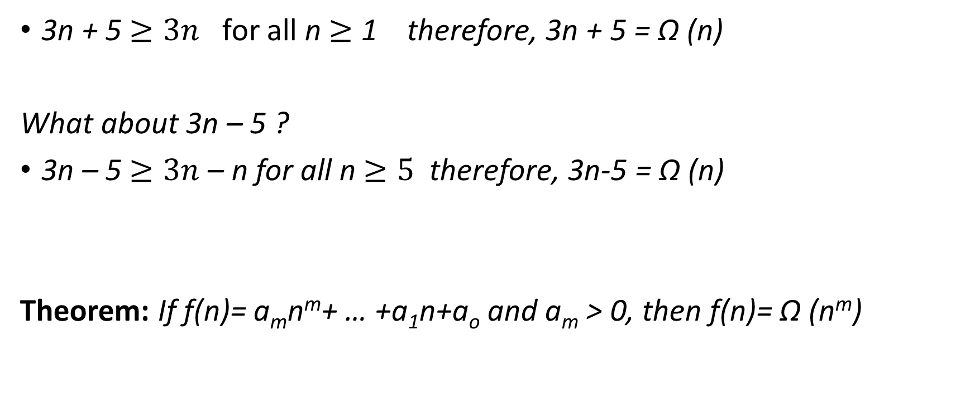
Examples
3n + 5 $≥3n$ for all n $≥$ 1 therefore, 3n + 5 = Ω (n)
What about 3n – 5 ?
3n – 5 $≥3n$– n for all n $≥5$therefore, 3n-5 = Ω (n)
Theorem: If f(n)= a_{m}n^{m}+ … +a₁n+a_{o} and a_{m} > 0, then f(n)= Ω (n^{m})

Slide 21
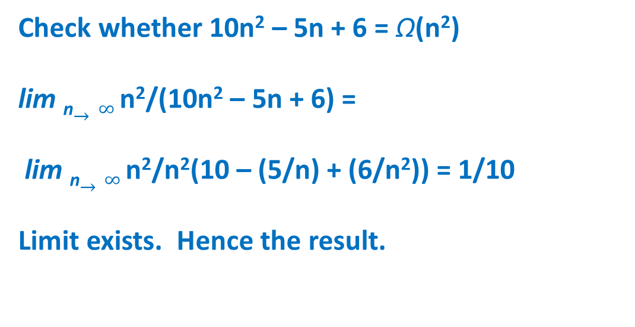
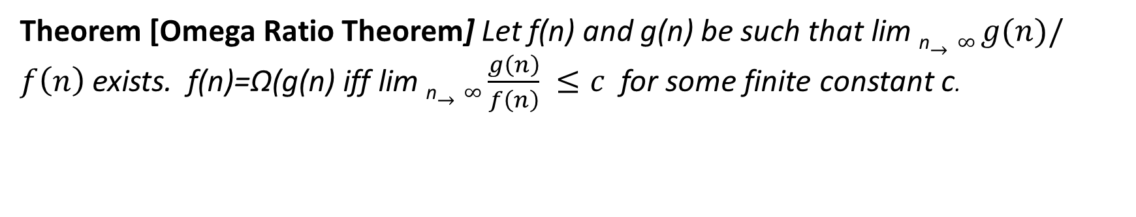
Omega Ratio Theorem
Theorem [Omega Ratio Theorem] Let f(n) and g(n) be such that lim _{n}$→∞ g(n)/f\left(n\right)$ exists. f(n)=Ω(g(n) iff lim _{n}$→∞\frac{g\left(n\right)}{f\left(n\right)} ≤c$for some finite constant c.
Check whether 10n² – 5n + 6 = Ω(n²)
lim _{n}$→∞ \text{n}\text{2}\text{/(1}\text{0}\text{n}\text{2}\text{ – 5}\text{n}\text{ + 6)}$ =
lim _{n}$→∞ \text{n}\text{2}\text{/}\text{n}\text{2}\text{(1}\text{0} \text{– }\text{(}\text{5}\text{/}\text{n}\text{)}\text{ + }\text{(}\text{6}\text{/}\text{n}\text{2}\text{)}\text{) = 1/10}$
Limit exists. Hence the result.

Slide 22
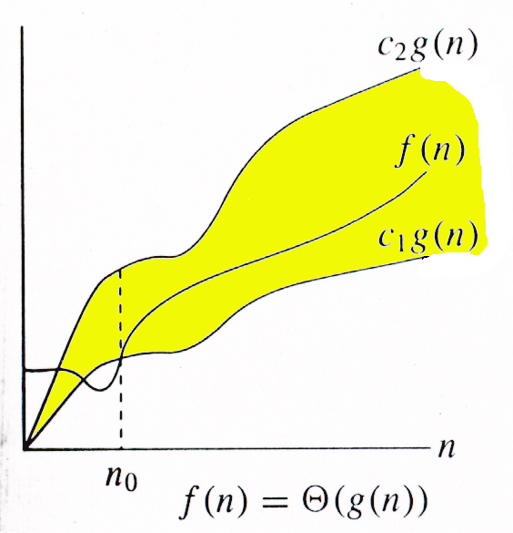
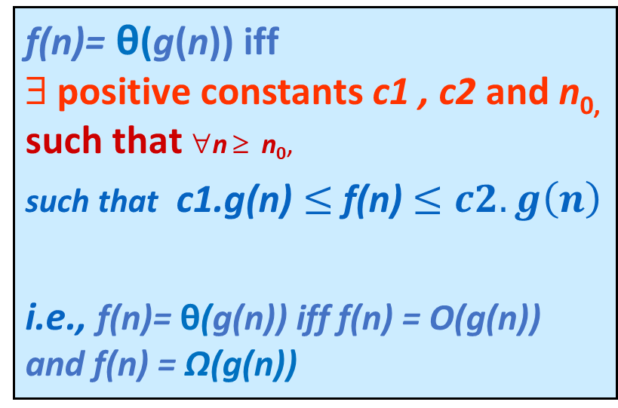
Theta Notation (θ)
f(n)= θ(g(n)) iff ∃ positive constants c1 , c2 and n_{0,} such that ∀n ≥ n₀,
such that c1.g(n) $≤$f(n) $≤c2.g\left(n\right)$
i.e., f(n)= θ(g(n)) iff f(n) = O(g(n)) and f(n) = Ω(g(n))
g(n) is an asymptotic lower and upper bound for f(n).

Slide 23
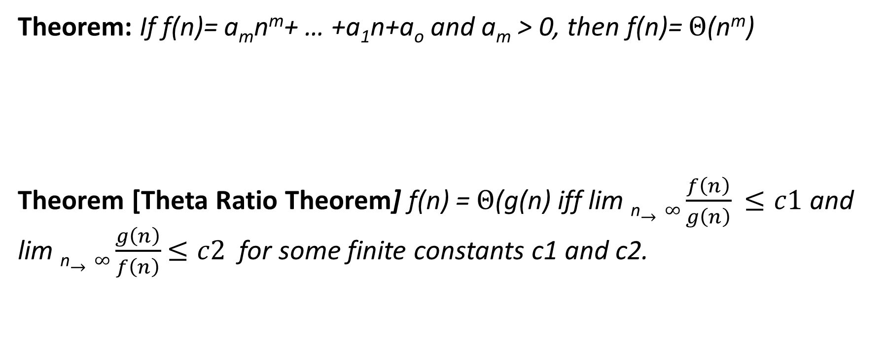
Theorem: If f(n)= a_{m}n^{m}+ … +a₁n+a_{o} and a_{m} > 0, then f(n)= $Θ$(n^{m})
Theorem [Theta Ratio Theorem] f(n) = $Θ$(g(n) iff lim _{n}$→∞\frac{f\left(n\right)}{g\left(n\right)}$ $≤c1$ and lim _{n}$→∞\frac{g\left(n\right)}{f\left(n\right)}$ $≤c2$for some finite constants c1 and c2.

Slide 24

Small Oh (o)
f(n) = o(g(n)) iff f(n)=O(g(n)) but f(n) ≠ Ω (g(n))
i.e., lim _{n}$→∞\frac{f\left(n\right)}{g\left(n\right)}$ = 0
Example 3n + 5 = o (n²) = o(n³)

Slide 25

Small Omega (ω)
f(n) = ω(g(n)) iff f(n)= Ω (g(n)) but f(n) ≠ O (g(n))
i.e., lim _{n}$→∞\frac{g\left(n\right)}{f\left(n\right)}$ = 0
3 N²+ 5 = ω(Ν)= ω (1)

Slide 26
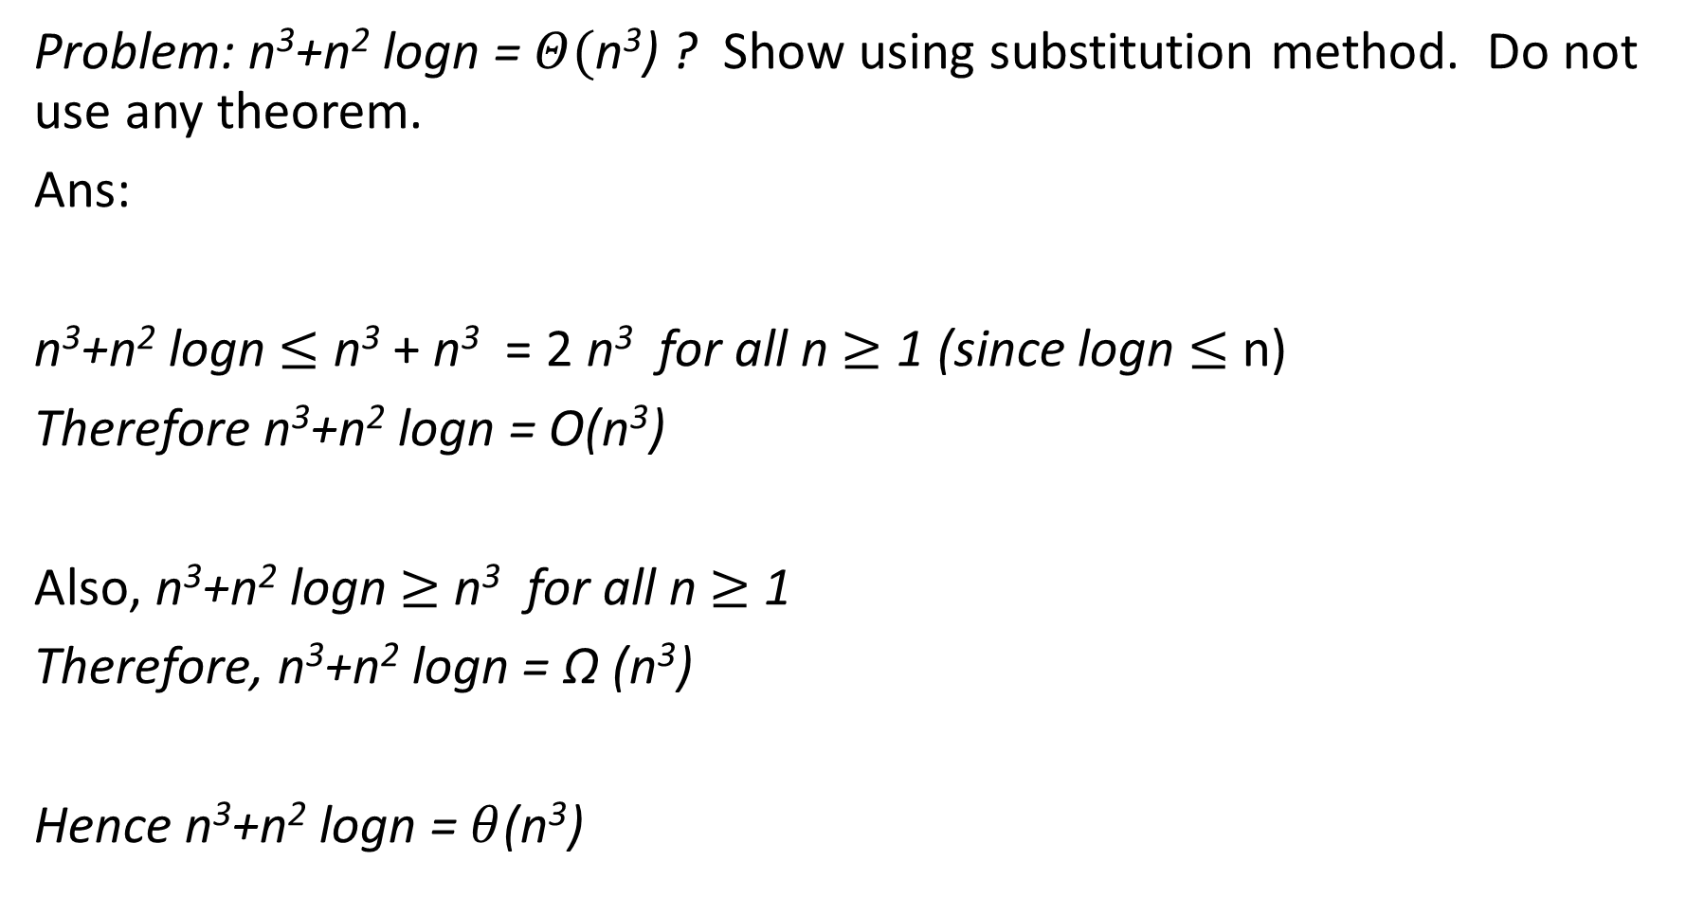
Problem: n³+n² logn = $Θ(\text{n}\text{3}$) ? Show using substitution method. Do not use any theorem.
Ans:
n³+n² logn $≤$ n³ + n³ = 2 n³ for all n $≥$ 1 (since logn $≤$ n)
Therefore n³+n² logn = O(n³)
Also, n³+n² logn $≥$ n³ for all n $≥$ 1
Therefore, n³+n² logn = Ω (n³)
Hence n³+n² logn = $θ$(n³)

Slide 27

Find the asymptotic time complexity of the following
$\sum{1n i}=$
$\sum{1n i2=}$
$\sum{1n i3=}$
n!
Express using Big Oh notation.

Slide 28

Find the asymptotic time complexity of the following
$\sum{1n i}=\frac{n\left(n+1\right)}{2}$
$\sum{1n i2=\frac{n\left(n+1\right)\left(2n+1\right)}{6}}$
$\sum{1n i3=\frac{n2\left(n+1\right)2}{4}}$
n!
O(max{mn², m²n}) = O(m³) if m > n else O(n³)
.

Slide 29
Thank You

